Slide 1

Ohio Manufacturing, Diversity, and Generations in the Workplace

Slide 2
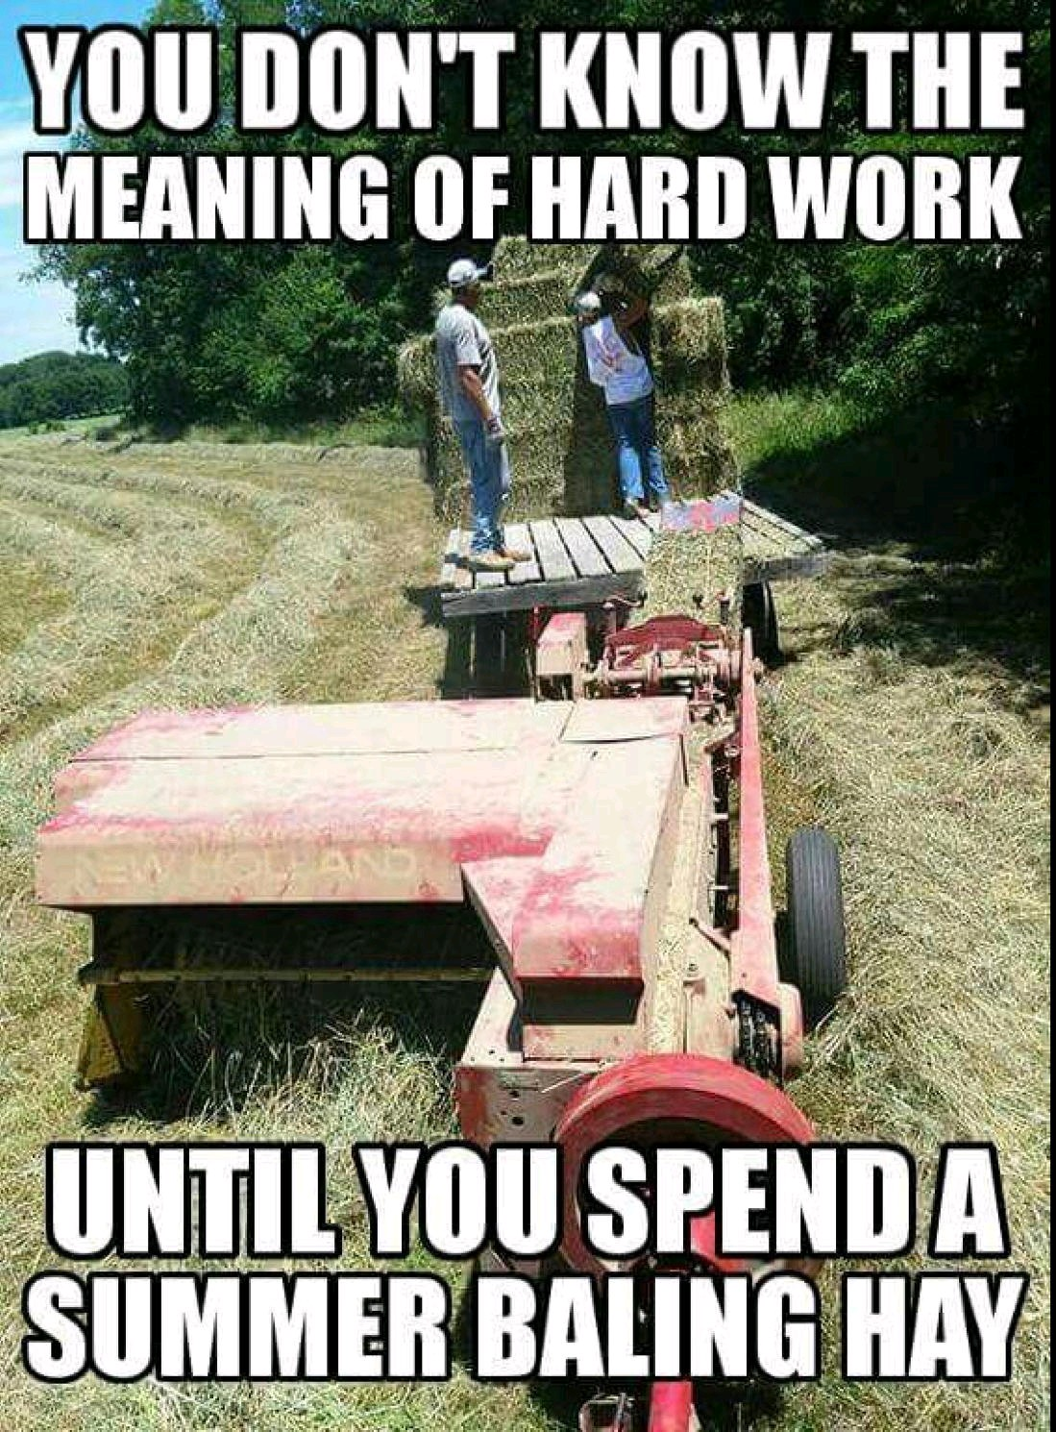

Slide 3
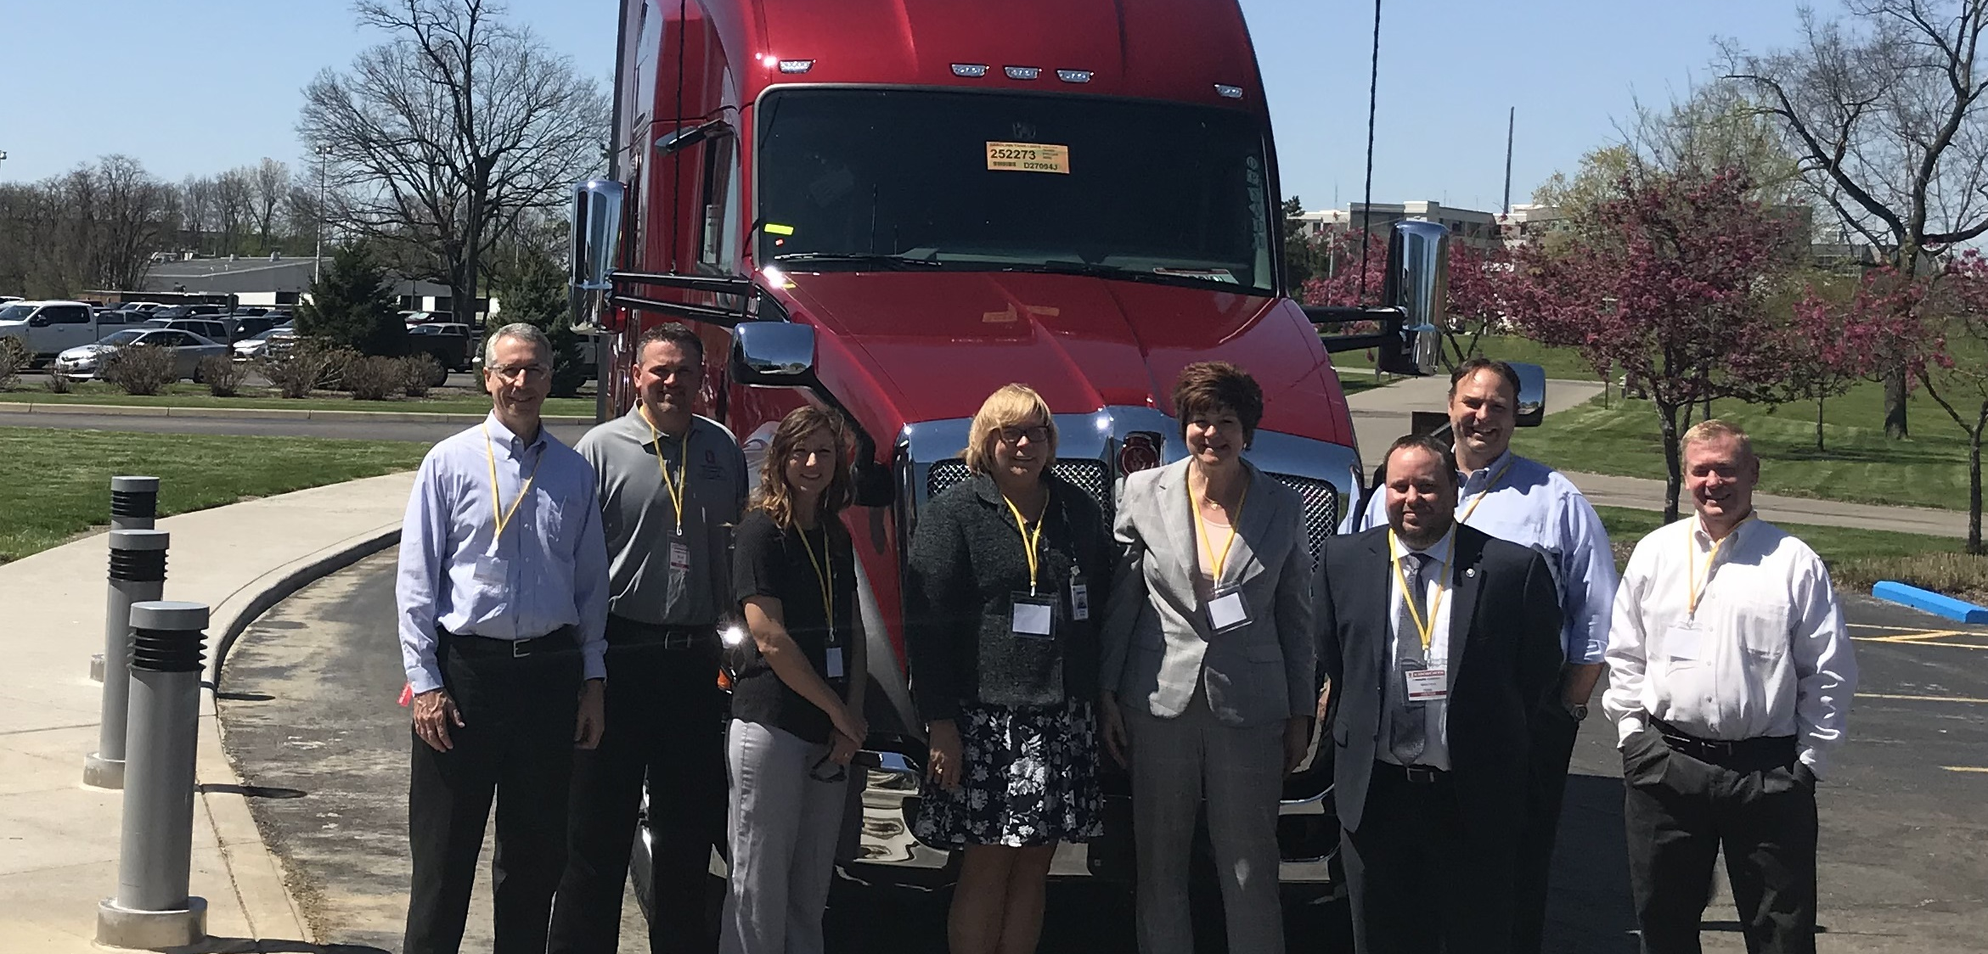


Slide 4

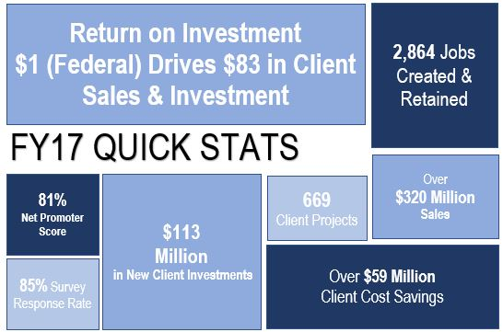






Ohio Manufacturing Extension Partnership (MEP)
https://vimeo.com/261192892
Driving productivity, growth, innovation
and global competitiveness for
Ohio’s manufacturers

Slide 5


What is MEP?
The Ohio Manufacturing Extension Partnership (MEP) works with manufacturers to help them create and retain jobs, increase profits and save time and money.
Ohio MEP serves as a trusted business advisor, focused on solving challenges and identifying opportunities for growth.
Ohio MEP is part of a statewide and national network.
The critical areas of services are operational support and quality, workforce, advanced manufacturing, and cybersecurity.

Slide 6

Ohio MEP SERVICES
Cybersecurity
• Evaluate Cybersecurity Risks
• Investing Cybersecurity Resources
• Determine Areas of Vulnerability
• Understand Organization’s Cybersecurity Risk
Operational Support and Quality
• Kaizen
• Kanban
• Project Management
• Lean Coaching, Leadership and Enterprise
• Standard Operating Procedures
• Green/Yellow/Black Belt
• Process Mapping
• Set up Reduction/ SMED
• Waste Reduction
• Six Sigma/Lean & 5S
• Supply Chain Development
• Statistical Process Control
• Root Cause Analysis
• Value Stream Mapping
• ISO 9001, 14001, 17025, 18001, 22001,
29001, 50001
• AS 9100, ASME, API, TS16949
• FMEA
• ISO and Quality Compliance, Consulting and Policy/Procedure Development
• Safety Compliance, Training, Consulting
Policy/Procedure Development
• OSHA Mock Audit
Workforce
• Leadership Development
• Five Behaviors of a Cohesive Team
• Facilitation Skills
• Time Management
• Change Management
• Coaching
• Leadership in a Lean Culture
• Everything DISC
• Career paths of internship, apprenticeship and incumbent worker training
• Sexual Harassment
• HR Compliance, Consulting and Policy/Procedure Development
• Train-the-Trainer
• Strategic Planning
Advanced Manufacturing
• Additive manufacturing
• Automation
• Robotics,
• IoT and Industry 5.0
• Product Design and Development
• Commercialization Management
• LEAN Product Development
• Growth Coaching
• Tech Transfer
• Testing and Validation
• Innovation Engineering

Slide 7
EXAMPLE Ohio MEP PROJECTS
Worked with a customer to reduce changeover time on a major product line from 16 to 11 days saving them $300,000 per day
Diagnosed and resolved problem with a customer in regard to holding tolerance on a part from Caterpillar to ensure Caterpillar business maintained
Created standard operating procedures for a client who has had 15% of their workforce retire and is implementing new production system first in corporation
Helped companies earn or maintain ISO certification to meet customer requirements
Offered Green Belt training to create internal CI champions who drive process improvement

Slide 8
OHIO MEP NEEDS ASSESSMENT SURVEY
497 verified responses from all around Ohio
Years in Operation:
Less than 4 4.9%
4-15 Years 11.9%
16 – 99 Years 74.3%
100 + Years 8.9%
Top 5 Sectors:
Fabricated Metal 28%
Machinery 14%
Plastics & Rubber 10%
Chemical & Coatings 8%
Transportation Equip 7%
Size by Employee:
20 or less 26.7%
21-50 23.9%
51-100 18.6%
101-250 18.6%
251 + 12.1%

Slide 9
OHIO MEP NEEDS ASSESSMENT SURVEY
Key Take-aways from Data Collected
Growth in manufacturing was strong last year and is anticipated to be strong again next year although optimism about the overall economy is decreasing
Except for basic automation, adoption of new technologies by manufacturers, especially small manufacturers, is very slow
Shortage of Talent continues to hamper growth with no end in sight
Governmental regulation concerns have decreased while shifting heavily to the negative impacts of tariffs on the majority of those surveyed

Slide 10

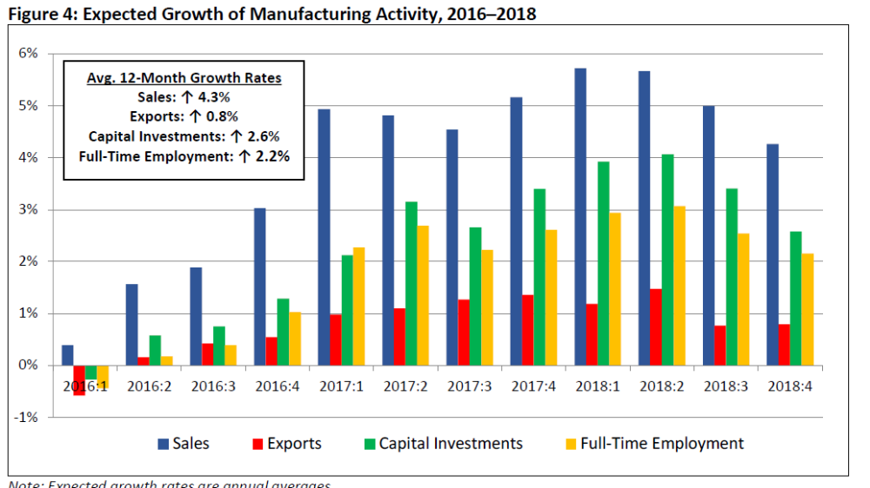
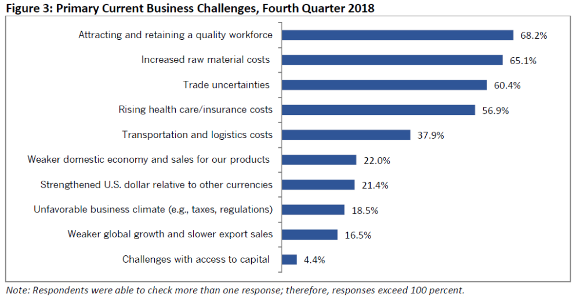
NAM MANUFACTURERS’ OUTLOOK SURVEY FOURTH QUARTER 2018 DECEMBER 20, 2018
Overall Facts About the Survey Number of Responses: 539
In the Field: November 28 to December 12, 2018
Small Manufacturers: 114 responses
Medium-Sized Manufacturers: 265 responses
Large Manufacturers: 160 responses

Slide 11
SURVEY
RESPONSES
If you answered “yes” to the previous question, how are you addressing the skills shortage? (Check all that apply.)
a. Working existing workforce more – 70.3%
b. Creating or expanding internal training programs – 65.5%
c. Encouraging possible retirees to stay longer in their roles – 30.7%
d. Collaborating with educational institutions on skills certification programs – 55.6%
e. Utilizing temporary staffing services – 57.7%
f. Working with local employment office – 32.1%
g. Considering moving operations to another location – 13.5%
h. Other – 10.4%
i. Uncertain – 2.2%
Do you have unfilled positions within your company for which you are struggling to find qualified applicants?
a. Yes – 76.6%
b. No – 20.4%
c. Uncertain – 3.0%
Because of my company’s inability to attract and retain workers, we have been unable to take on new
business and have lost revenue opportunities.
a. True – 28.8%
b. False – 56.9%
c. Uncertain – 14.3%

Slide 12

TIME TO EXERCISE…
MANUFACTURING FACTS QUIZ

Slide 13
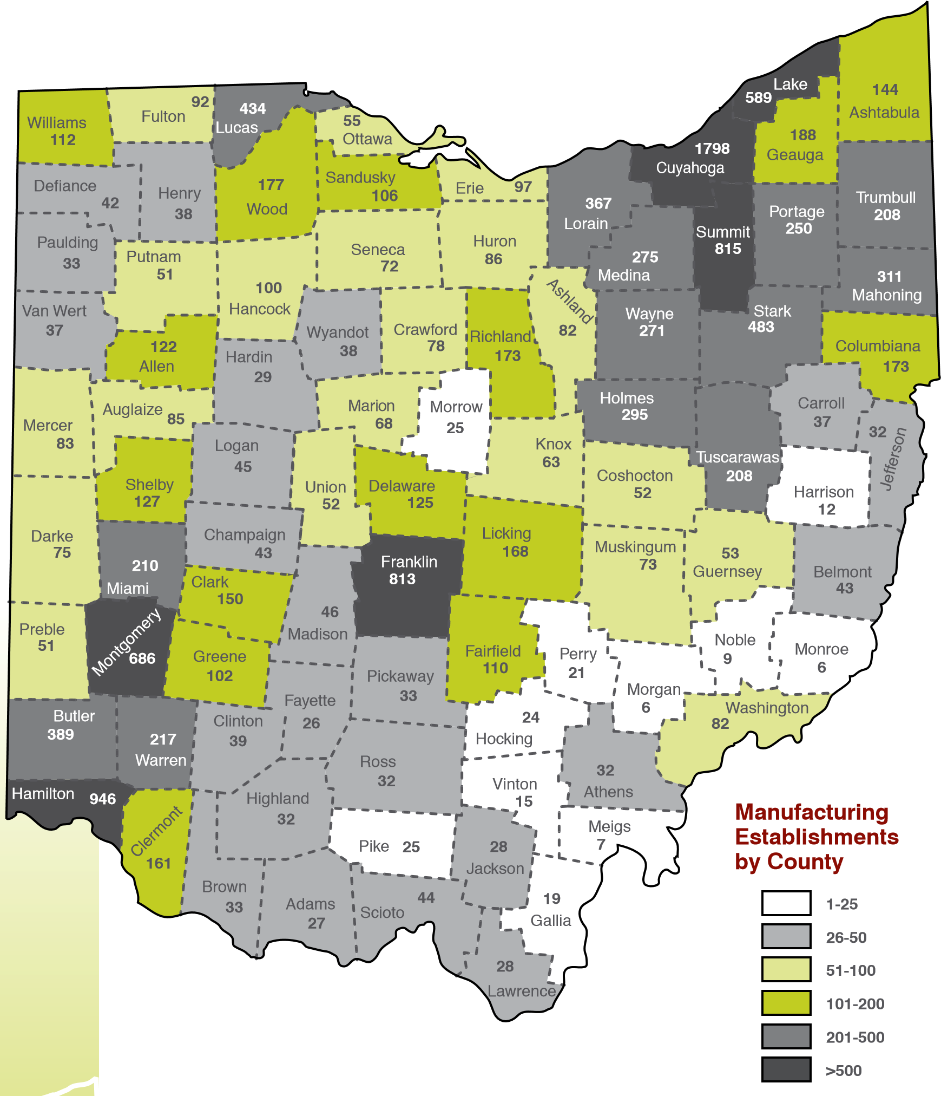
Manufacturing
Facts
FACT: Ohio ranked second nationally in the number of new site selections in the past 5 years, bested only by Texas.
FACT: Typically about one-half of Ohio’s new site selection projects are manufacturing projects

Slide 14
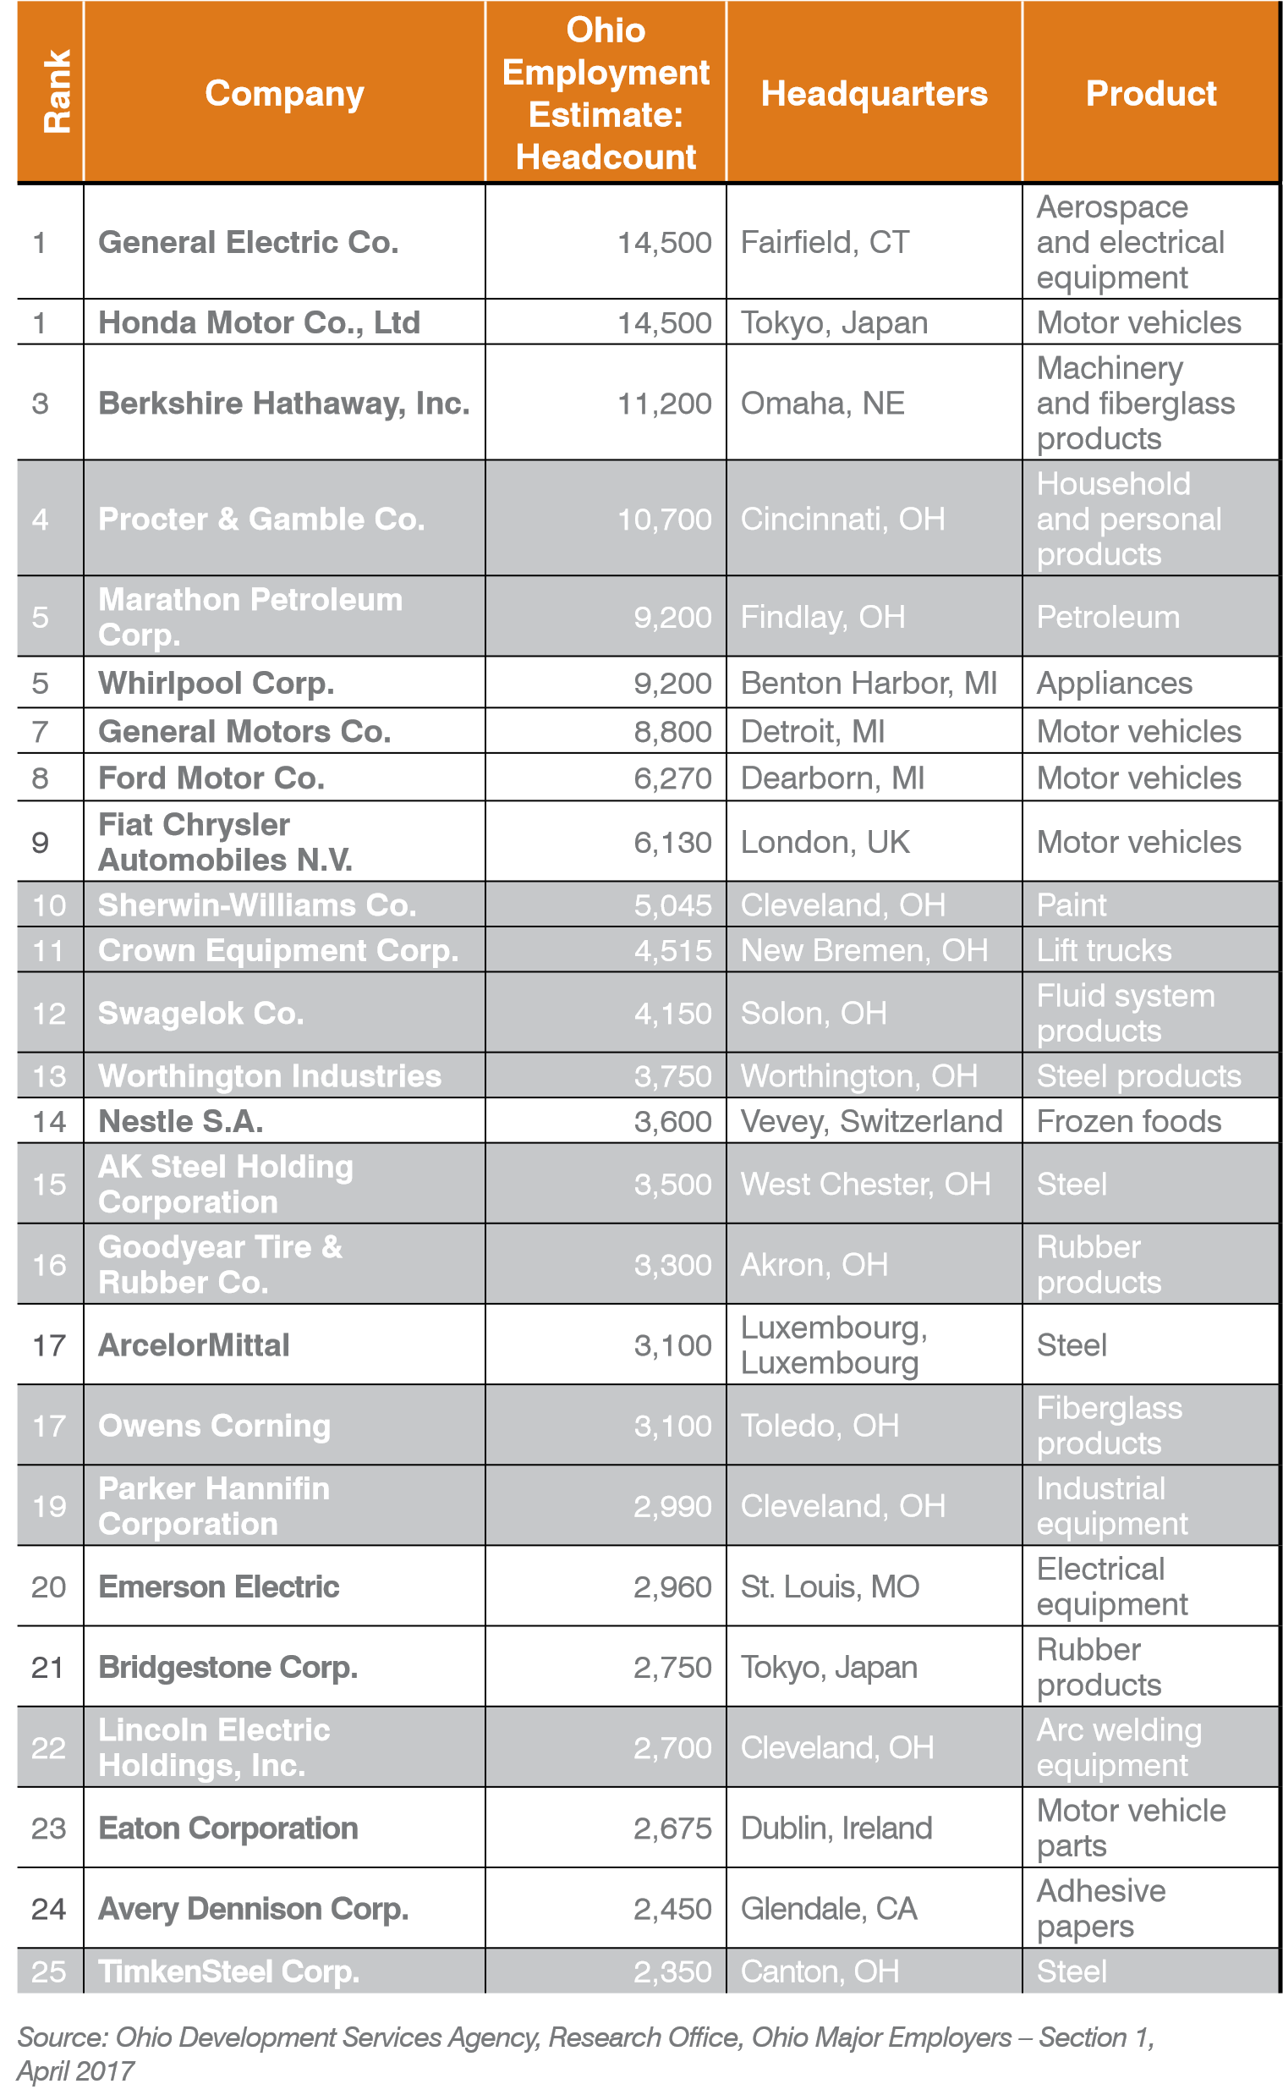
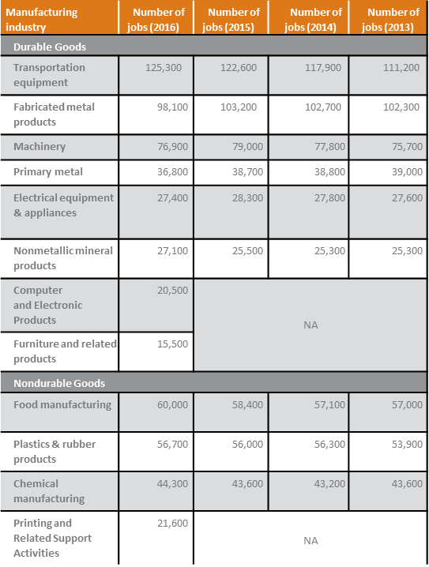
OHIO’S LEADING MANUFACTURING EMPLOYERS
TRADITIONAL INDUSTRIES CONTINUE TO BE OHIO’S MANUFACTURING JOB PRODUCERS

Slide 15
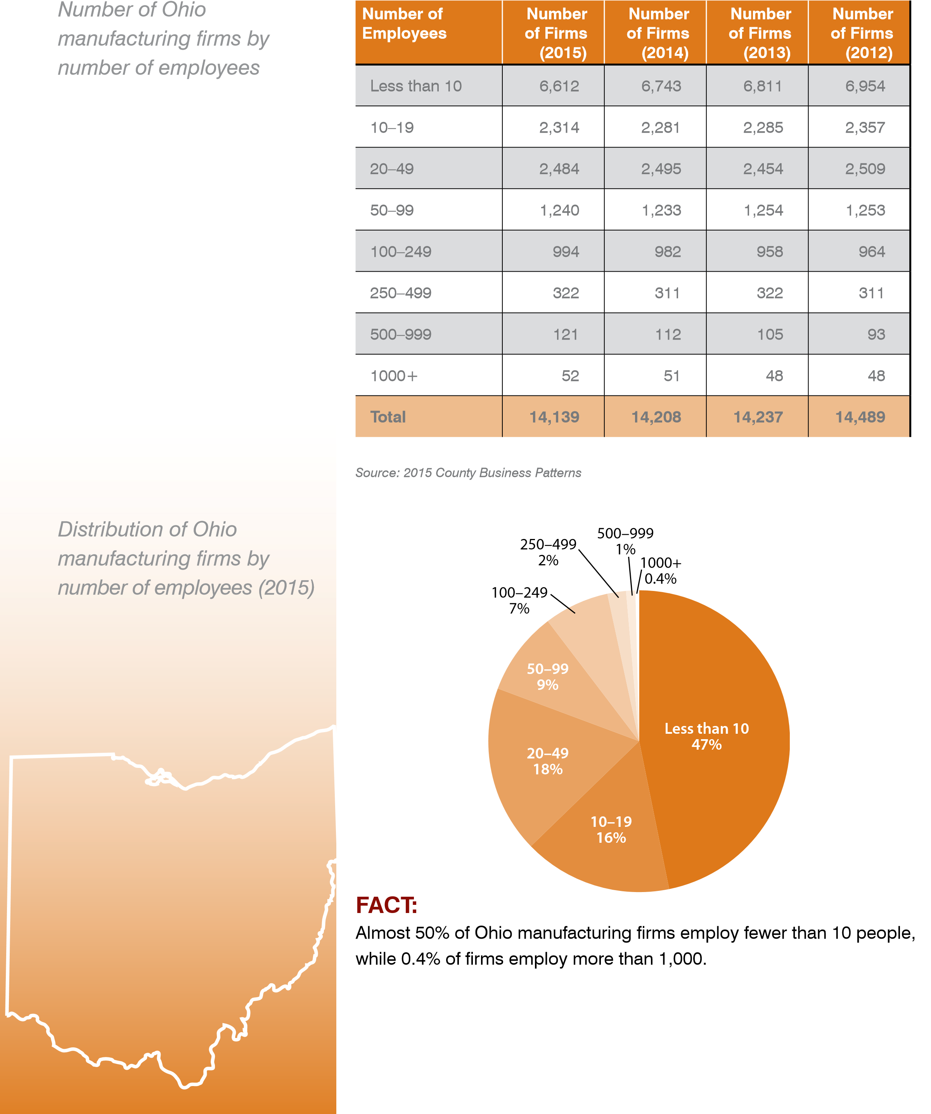
OHIO MANUFACTURING & JOBS
MANUFACTURING MEANS LARGE AND SMALL BUSINESSES IN OHIO
Distribution of Ohio manufacturing firms by
number of employees (2015)
Number of Ohio manufacturing firms by
number of employees

Slide 16
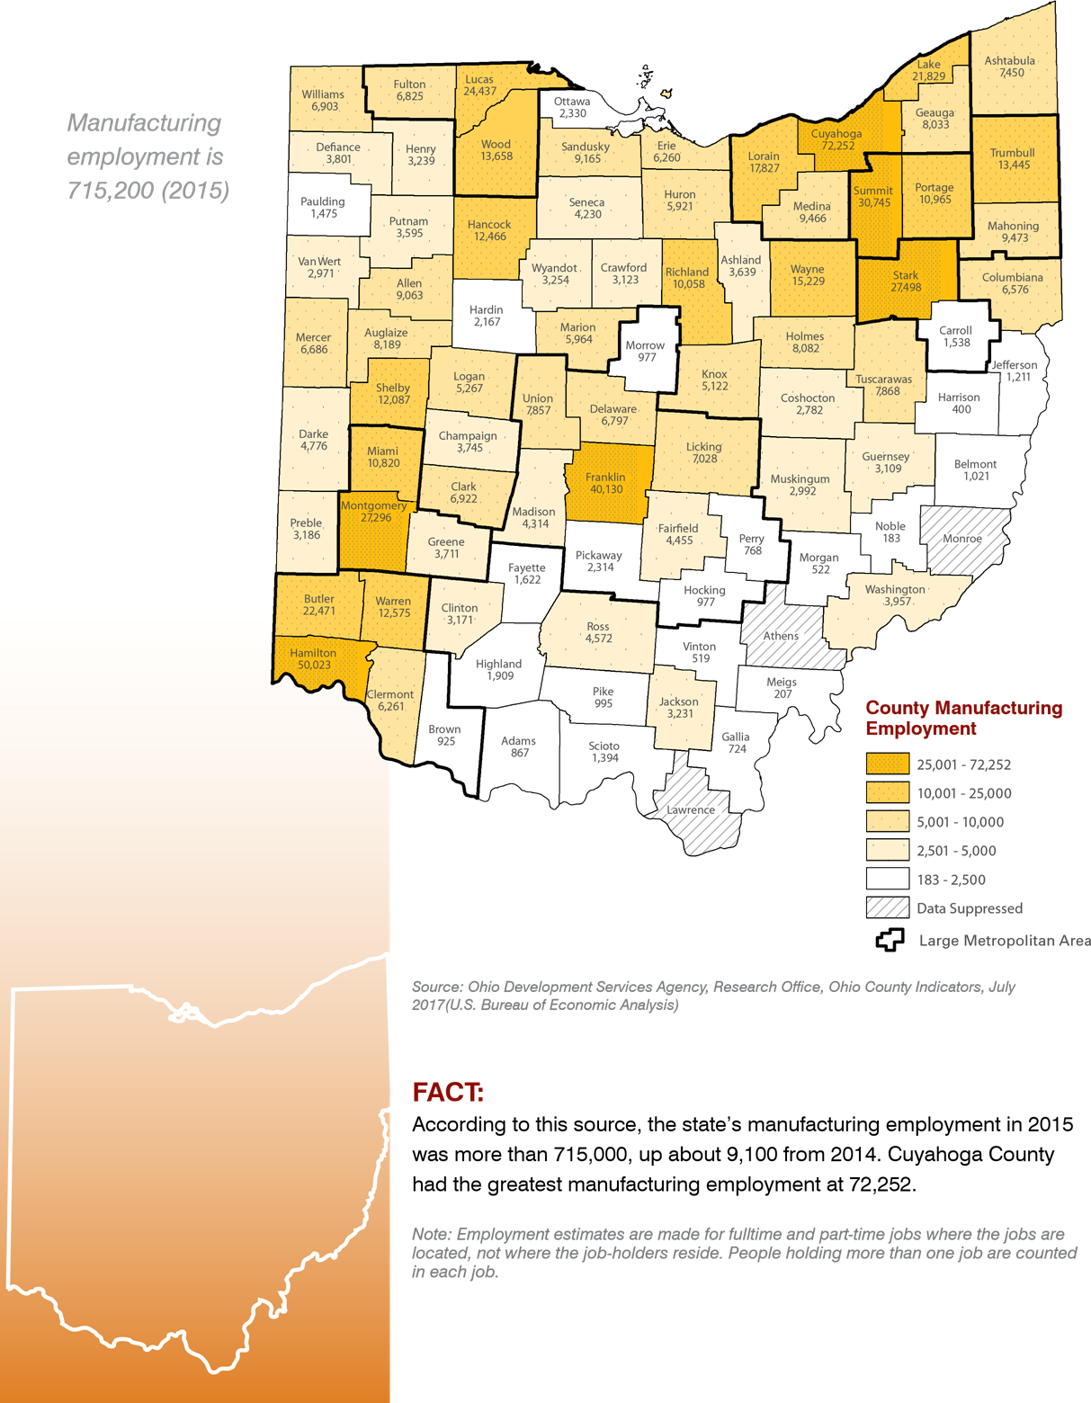

Manufacturing employment
715,200 (2015)

Slide 17
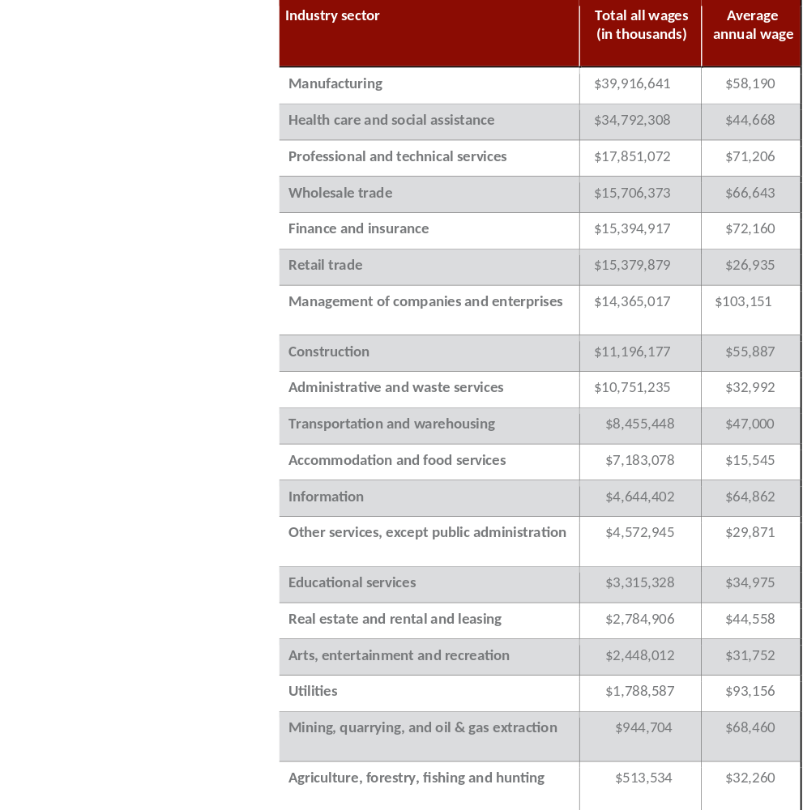

OHIO ANNUAL PAYROLL BY INDUSTRY SECTOR
(2015)

Slide 18
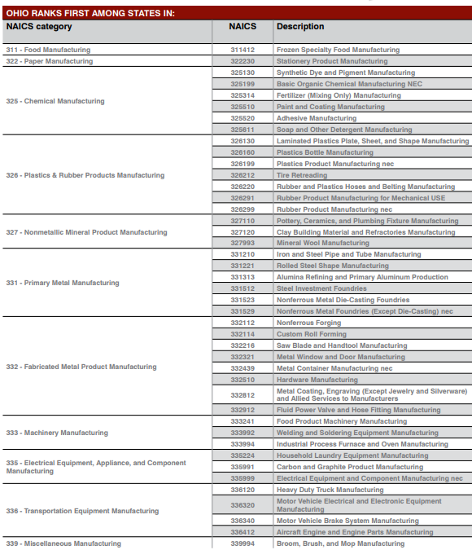

OHIO MANUFACTURING
COMPARED TO
U.S. MANUFACTURING

Slide 19
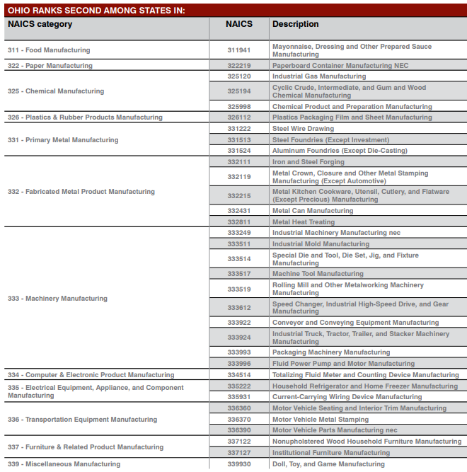

OHIO MANUFACTURING
COMPARED TO
U.S. MANUFACTURING

Slide 20
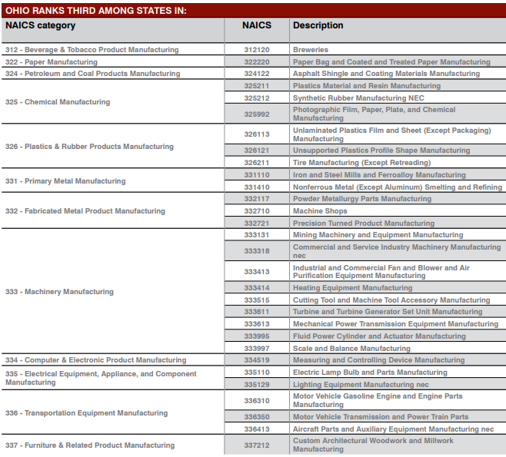

OHIO MANUFACTURING
COMPARED TO
U.S. MANUFACTURING

Slide 21
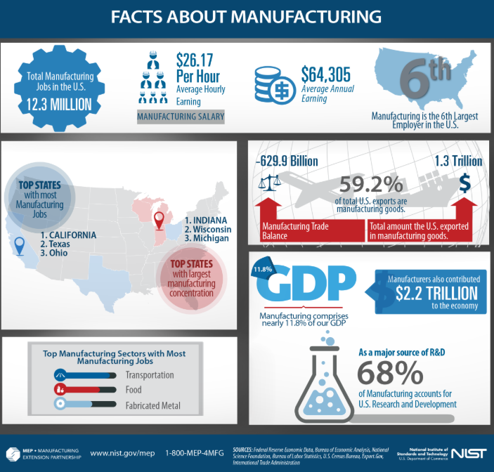


Slide 22

DIVERSITY DEFINED
Diversity is the mosaic of people who bring a variety of backgrounds, styles, perspectives, values and beliefs as assets to the groups and organizations with which they interact.

Slide 23

DIVERSITY & INCLUSION, LIKE ALL CORE VALUES,
MUST BE BUILT IN…NOT PASTED ON.

Slide 24
Younger workers see lack of diversity as a barrier to progress
In a recent PwC survey, across all industries, respondents agreed or strongly agreed
that lack of diversity is a barrier to progression in their organization
Age 30-39
46
%
Age 60+
20
%
Source: Global PwC study: Diversity & Inclusion Benchmarking Survey, 2017

Slide 25
The challenge of diversifying manufacturing in 2017
Attracting a diverse pool of
Intercultural
candidates for open positions
integrations
84.5
%
28.4
%
US manufacturers and industrial
US manufacturers rated
production professionals rated as
as “very high” or “high”
“very high” or “high” challenge
challenge
Source: “Help Wanted! Results of the 2017 Plant Service Workforce Study”, plantservices .com, February 14, 2017 .

Slide 26
Nearly half of consumer and industrial products companies
are rolling out D&I training
In a recent PwC survey
48
%
45
%
offer training
are expanding
on embracing
training to focus
differences in
on how to embed
the workplace
inclusive behaviors
into everyday job
responsibilities
Source: Global PwC study: Diversity & Inclusion Benchmarking Survey, 2017

Slide 27
The percentage of CEOs who said they focused
on talent diversity and inclusiveness
2015
64
%
2017
87
%
Sources: 2015 PwC Annual Global CEO Survey and 2017 PwC Annual Global CEO Survey

Slide 28
US manufacturing employment by industry,
sex, race, and ethnicity in 2017
Total: 15.4 Million
79.9
%
71.5
%
29.5
%
16.6
%
10.1
%
7.1
%
Men
Women
White
Black
Asian
Hispanic/
Latino
Source: US Bureau of Labor Statistics
https://www .bls .gov/cps/cpsaat18 .ht
m

Slide 29
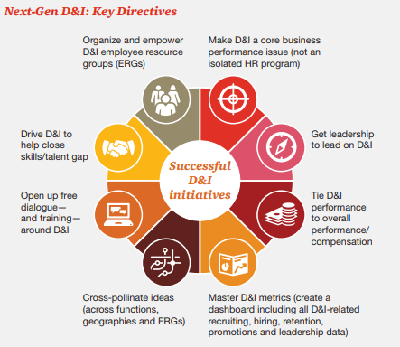

Slide 30

DIVERSITY & INCLUSION IS MORE THAN THE BIG THREE:
Race & Ethnicity
Culture & Religion
Age, Gender & Sexual Orientation

Slide 31
Communication
Style
Geographic
Location
Organizational
Role and Level
PRIMARY AND SECONDARY
DIMENSIONS OF DIVERSITY
Education
Race
Age
Religion
Gender
Family
Status
Sexual
Orientation
Disability
Work
Experience
Ethnic
Heritage
First
Language
Socioeconomic
status
Military
Experience
Work/Thinking
Style

Slide 32
DIVERSITY & INCLUSION GOALS:
MAKING FULL USE OF THE UNIQUE SKILL SETS OF EACH EMPLOYEE
My ideas
My opinions
My background
My personality
My uniqueness
Food for Thought:
Do I bring my “full self” to work?

Slide 33

BENEFITS OF WORKFORCE DIVERSITY & INCLUSION
Improved understanding of those you work for, with, and around.
Creates a work environment that allows everyone to reach their full potential.
Provides multiple perspectives on problem solving.
Increases employee productivity.
Increased retention rates.
Improved customer relations.
Reduces complaints and grievances.
It’s the right thing to do!

Slide 34
Organizational Inclusion
Extent to which the organization provides fair and equitable treatment to all employees and groups.
Equity of Practices
Extent to which culture avoids assimilationist strategies and is open to learning from different and non-traditional sources.
Organizational Culture
Extent to which the organization draws upon diverse sources of knowledge and experience for planning and operations.
Voice & Participation

Slide 35

1
Practice positive, constructive work habits in the workplace; work cooperatively towards a common goal.
HOW CAN EMPLOYEES
PROMOTE DIVERSITY
1
2
Live up to the social contract; contribute to your fullest potential; strive for excellence.
1
3
1
Recognize and respect others and their individuality.
4
1
Think before you speak and be sensitive to others.
5
Talk about your differences and ask tactful questions about how people want to be treated.
1
6
1
Eliminate stereotypes and generalizations.

Slide 36

Everything DiSC® is a personality assessment tool that measures preferences and tendencies that shape the workplace experience. Based on an individual’s assessment data, a customized report provides a wealth of information about his or her style.

Slide 37
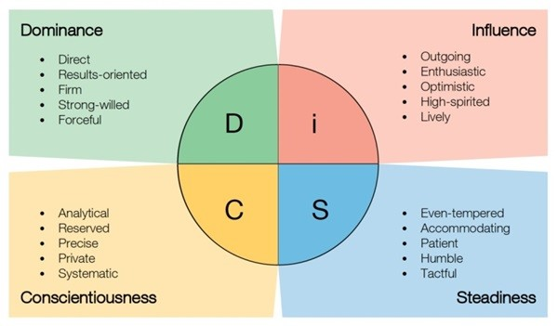

Slide 38
Time to Exercise…
DiSC and Career Match

Slide 39
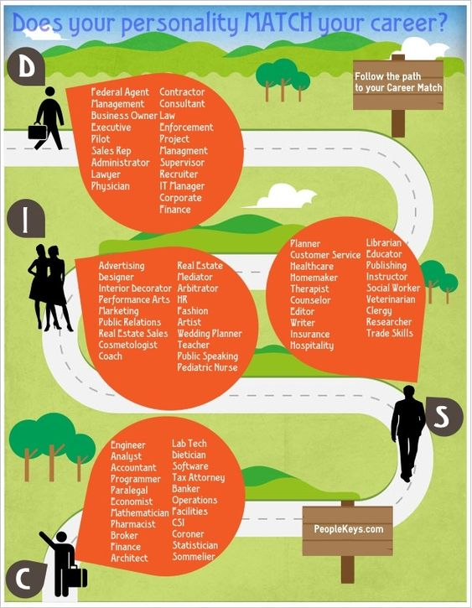
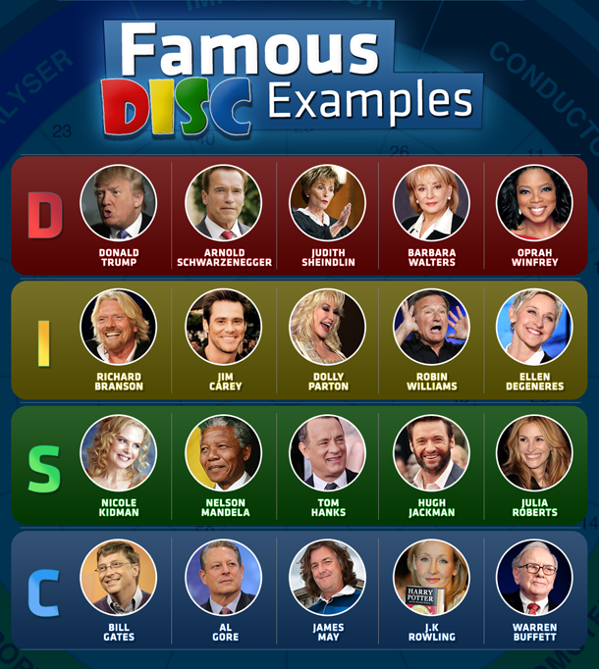

Slide 40

DOMINANT STYLE
OBSERVABLE CHARACTERISTICS | SO YOU…..
Wants to be #1 | Show them how to win
Think logically | Show reasoning ability
Wants an overview of the facts | Skip the details
Wants accomplishments noticed | Compliment them on what they have done
Wants to be in charge | Let them take the lead….. with parameters
Likes change and choice | Vary the routine and let them do their thing

Slide 41

INFLUENCING STYLE
OBSERVABLE CHARACTERISTICS | SO YOU…..
Likes enthusiastic people and optimism | Behave optimistically – support their ideas
Thinks emotionally | Support their feelings
Concerned with approval and appearances | Show that you like and admire them
Wants broad and general expectations | Focus on big picture – avoid details
Likes change and innovation | Avoid assigning repetitive tasks
Wants to be noticed | Compliment them personally and often

Slide 42

STEADINESS STYLE
OBSERVABLE CHARACTERISTICS | SO YOU . . .
Thinks logically | Show reasoning
Wants documentation and facts | Provide data and proof
Concerned with stability | Show how your ideas minimize risk
Likes personal involvement | Demonstrate your interest in them
Wants sincere feedback and recognition | Notice their patience and perseverance
Dislikes conflict | Behave in a non-aggressive way

Slide 43

CONSCIENTIOUSNESS STYLE
OBSERVABLE CHARACTERISTICS | SO YOU…..
Thinks logically | Show reasoning – tell them why and how
Dislikes aggression | Approach in a non-threatening way
Asks questions and seeks data | Give data – detailed and in writing
Uses caution – needs time to think | Allow time to question and inquire
Wants others to notice their accuracy | Compliment them on their thoroughness
Avoids conflict | Be tactful when asking for clarification

Slide 44
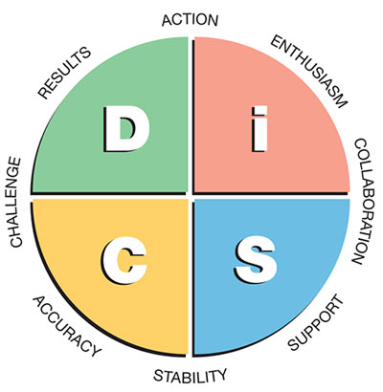
POPULATION BREAKDOWN
D - 19%
i – 32%
S – 35%
C – 14%
44

Slide 45
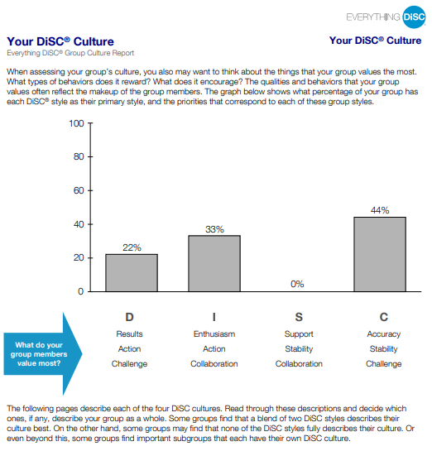
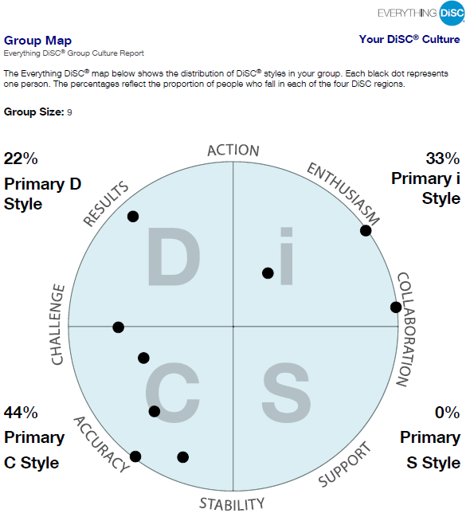
SAMPLE MANUFACTURING COMPANY DISC GROUP REPORTS

Slide 46
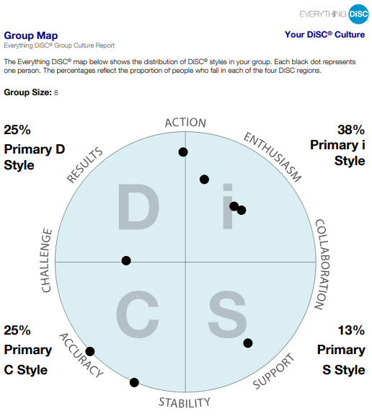
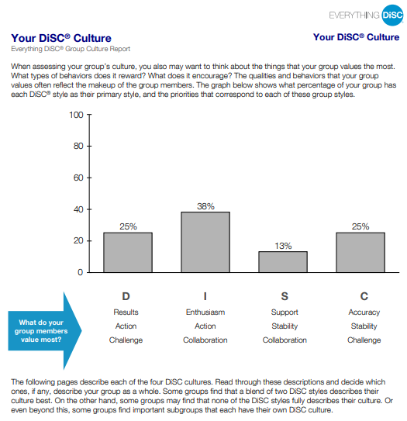
SAMPLE MANUFACTURING COMPANY DISC GROUP REPORTS

Slide 47
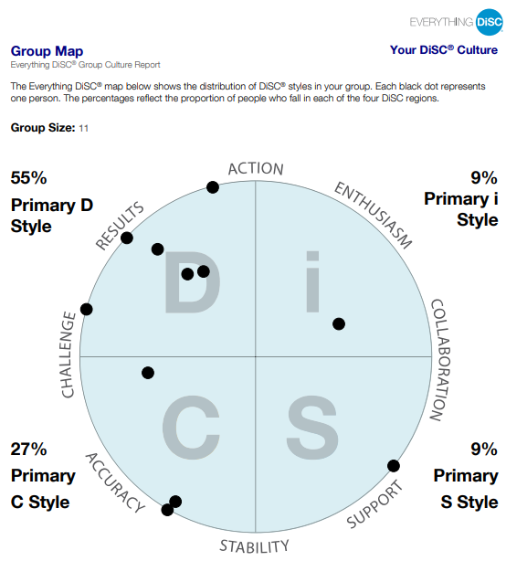
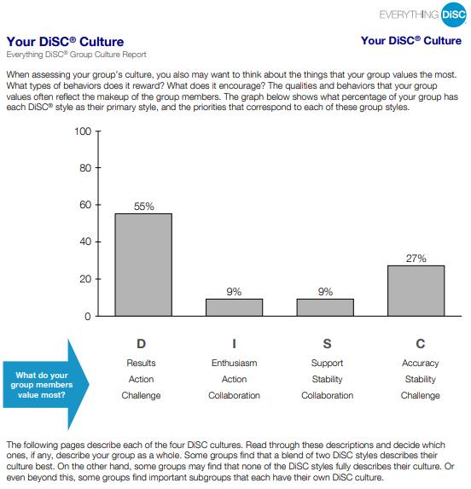
SAMPLE MANUFACTURING COMPANY DISC GROUP REPORTS

Slide 48
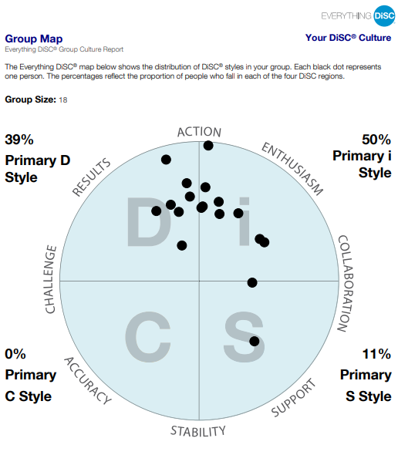
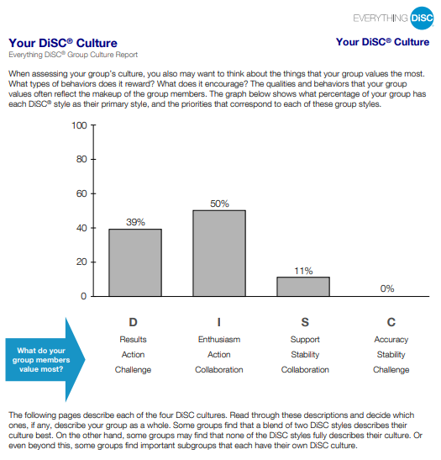
SAMPLE MANUFACTURING COMPANY DISC GROUP REPORTS

Slide 49
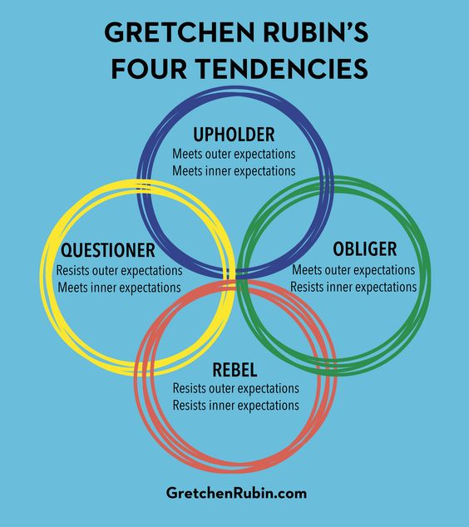

Slide 50

• They’re self-directed, so they meet deadlines and run projects without much supervision.
• They’re eager to meet expectations (rules, regulations, performance targets) and may become uneasy when it’s not clear what’s expected.
• They embrace routine and may struggle to adjust to changes in scheduling or process.
• They may have trouble delegating, because they suspect that others aren’t dependable.
• They may be judgmental of others who won’t or don’t meet expectations easily.
• They can seem uptight or rigid.

Slide 51
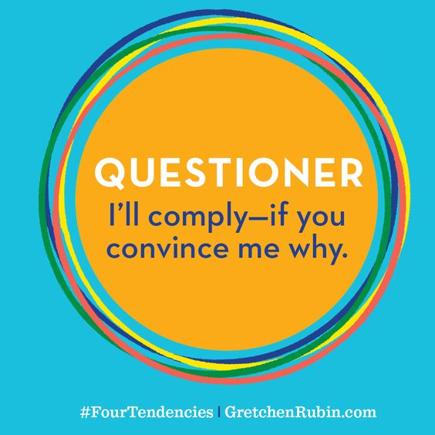
• They put a high value on reason, research, information, and efficiency.
• Managers should ensure that Questioners get the robust explanations they need to meet expectations—not “Because I say so” or “This is how we’ve always done it.”
• They follow an “authority” only if they respect that person.
• Because of their persistent questioning, others may view them as uncooperative, obstructionist, disrespectful, or “not a team player.”
• They often dislike being questioned themselves.
• They resist anything arbitrary—such as “The report can’t be longer than twenty pages.”
• They can suffer “analysis-paralysis” when their desire for perfect information prevents them from being able to make a decision.

Slide 52

• They put a high value on meeting commitments to others and going the extra mile—“I’ll do anything for my client/team/customer.”
• They require supervision, deadlines, monitoring, and other forms of accountability.
• They may have trouble saying “no” or setting limits on others’ demands.
• Managers should ensure that Obligers aren’t exploited by others, that work is distributed fairly, and that Obligers take time off.

Slide 53

• To inspire a Rebel to act, it’s most effective to appeal to their identity, or to use the framework of information-consequence-choice.
• Perhaps surprisingly, some Rebels are attracted to professions of
high regulation such as police and the military.
• If they have a work partner, that partner is probably an Obliger.
• They may act as though ordinary rules don’t apply to them; this may be an advantage, for instance, in sales.
• They’re often restless and may find it difficult to settle down in a job or particular office.
• They may choose to act out of a sense of mission or a belief in a cause.
• They don’t respond well to supervision, advice, reminders, or directions, and they resist routines, schedules, and repetitive tasks.
• They put a high value on freedom, choice, self-expression, and authenticity; they can do anything they want to do but will resist if someone tells them what to do.

Slide 54
Time to Exercise…
Four Tendencies Quiz

Slide 55




QUIZ SCORING
a = Upholder; b = Questioner; c = Obliger; d = Rebel
a = Questioner; b = Obliger; c = Rebel; d = Upholder
a = Questioner; b = Rebel; c = Obliger; d = Upholder
a = Upholder; b = Questioner; c = Obliger; d = Rebel
a = Upholder; b = Questioner; c = Obliger; d = Rebel
a = Obliger; b = Upholder; c = Rebel; d = Questioner
“Tend to agree” indicates Rebel
“Tend to agree” indicates Questioner
“Tend to agree” indicates Obliger
“Tend to agree” indicates Rebel
“Tend to agree” indicates Obliger
“Tend to agree” indicates Rebel
“Tend to agree” indicates Questioner

Slide 56

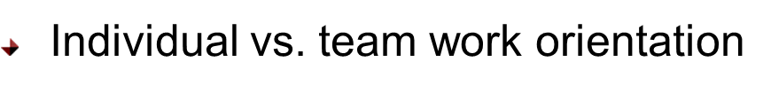
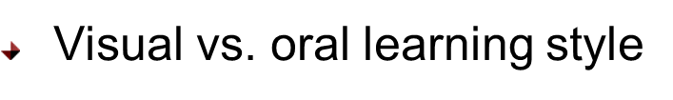
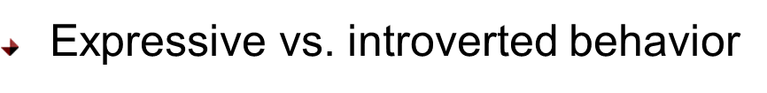
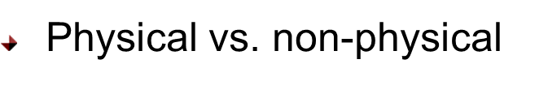
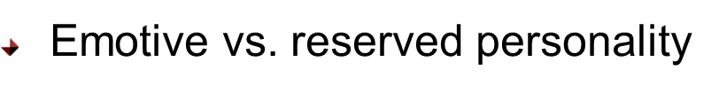
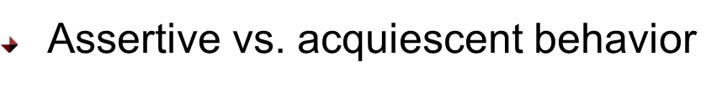



CULTURAL / GENERATIONAL DIFFERENCES

Slide 57
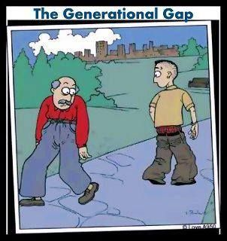
A NEW GENERATION GAP
“ The term Generation Gap was used mostly to describe conflicts between parents and children. Today, the “Gap” has more of a presence in the workplace, where employees from different generations are finding it difficult to work side by side because their experiences, goals and expectations are different”.
GOVEXEC.com

Slide 58
NATURE VS. NURTURE-BOTH ARE IMPORTANT INFLUENCES ON BEHAVIOR
Recognizing Generational Traits is a tool to help us better work together as members of a group.
Each of us is the product of both nature & nurture.
Nurture has three levels:
Family
Community
Cultural/Global
Generational traits are an expression of cultural/global nurture

Slide 59






EVENTS THAT SHAPE A GENERATION
RELATIONSHIPS
PARENTS
NATIONAL EVENTS
VALUES
MUSIC
TECHNOLOGY

Slide 60
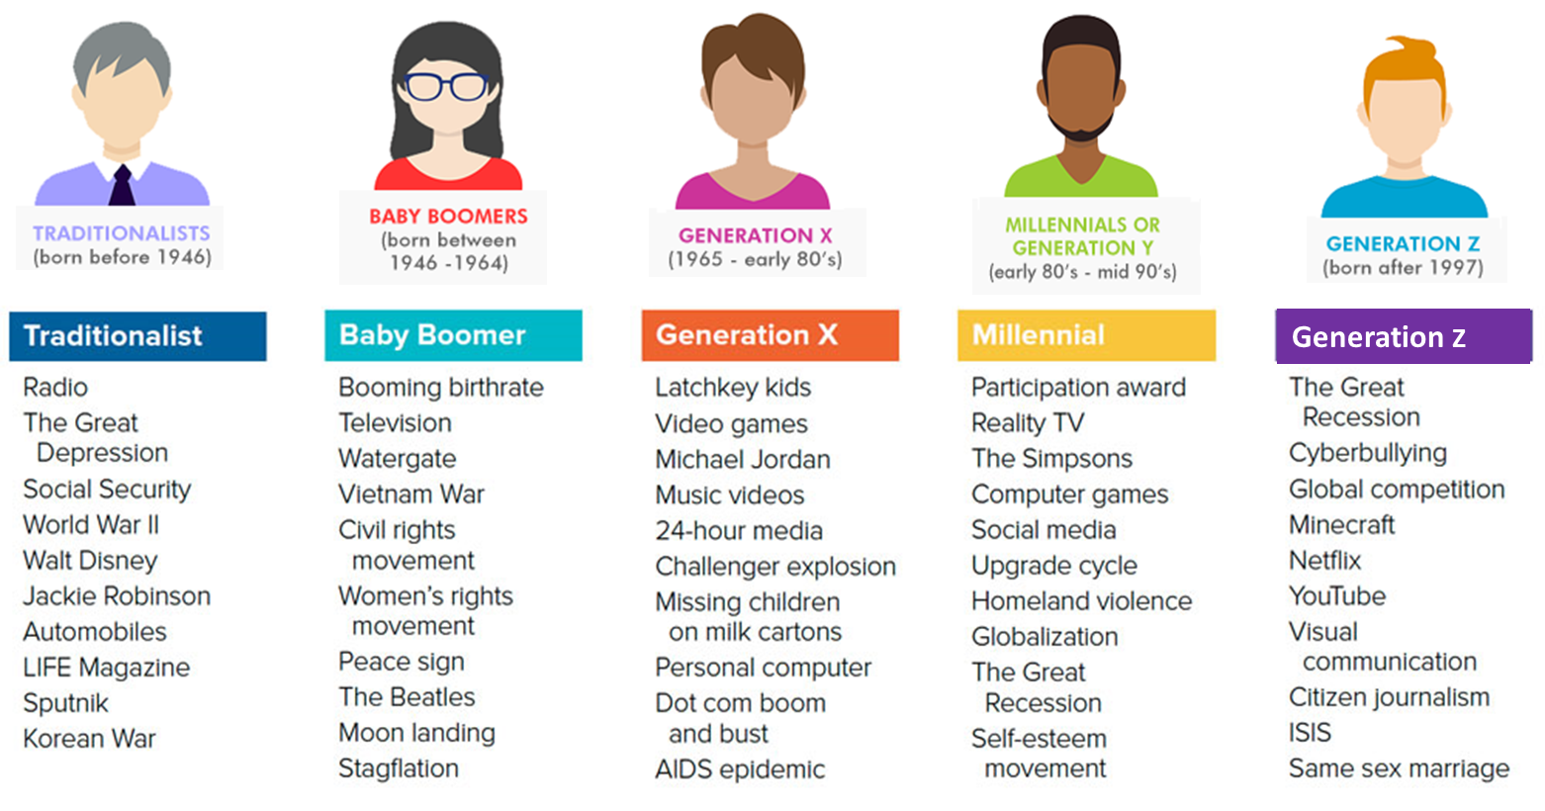
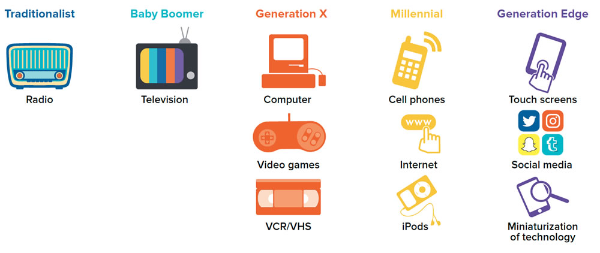
AND NEXTGEN IS ON THE WAY……

Slide 61
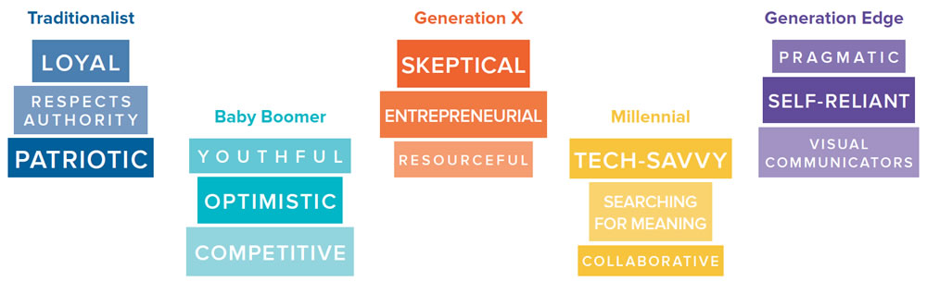
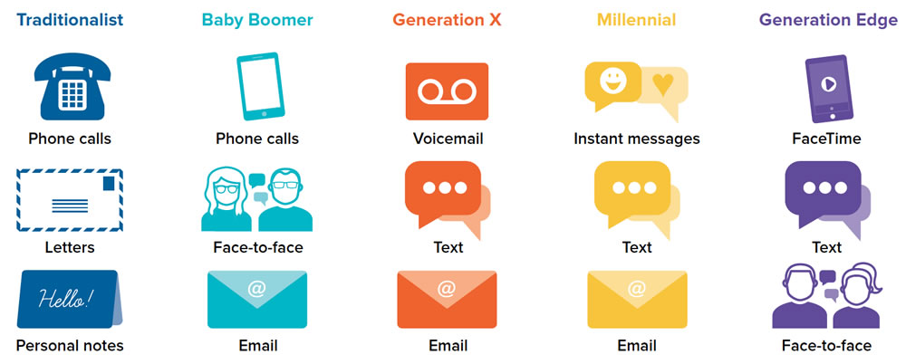
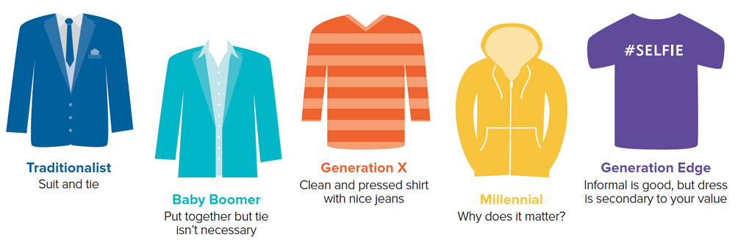
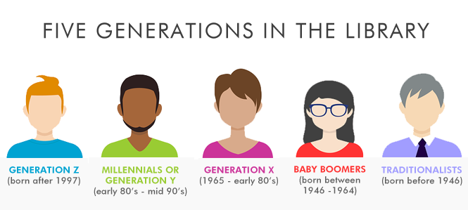
TRADITIONALIST
BORN BEFORE 1946

Slide 62
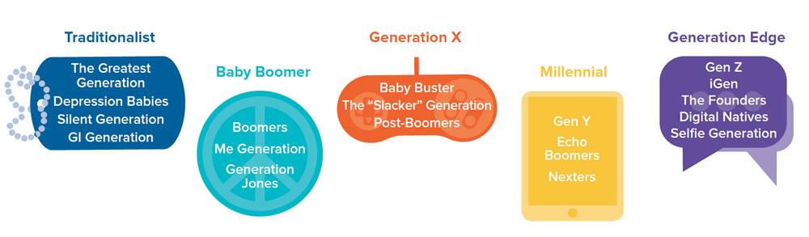
TRADITIONALIST
BORN BEFORE 1946
Grew up with many rules and pressure to conform
“Work First!”
Children should be seen and not heard
Expected lifetime career with one employer
Prefer communication in writing
Desire to leave a lasting legacy
Increased prosperity over their lifetime; however, they remember the Depression

Slide 63
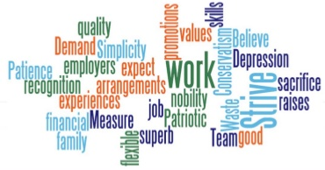
WORKING WITH THE TRADITIONALIST
Believe raises, promotions, and recognition should come from job tenure
Loyal to employees and expect the same in return
Posses superb interpersonal skills
Measure work ethic on timeliness, productivity, and not drawing attention
GETTING ALONG WITH
THE TRADITIONALIST
Honor the chain of command
Value the legacy they have built
Value their experience
Appreciate their dedication
Communicate one-on-one
Learn the corporate history
MANAGING THE TRADITIONALIST
Offer opportunities for them to mentor
Offer opportunities to continue working
Allow them to volunteer if they do not want to continue working
Show them that you value their expertise and contributions

Slide 64
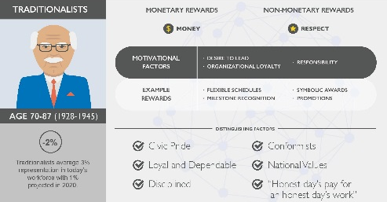

Slide 65
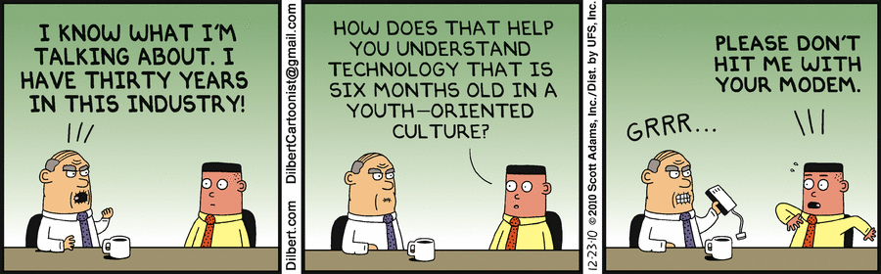
YOU MIGHT BE A TRADITIONALIST IF……
YOU HAVE THE ABILITY TO ENTERTAIN YOURSELF WITHOUT A TV, IN FACT YOU REMEMBER THE DAYS WITHOUT TV.

Slide 66
BABY BOOMERS
BORN BETWEEN 1946-1964

Slide 67
BABY BOOMER
BORN BETWEEN 1946-1964
Grew up with fewer rules and a more nurturing environment
Lived in generally prosperous times, but experienced layoffs
Women entered workforce in record numbers
“Live to Work!”
Spend “quality time” with children
Excelling in their career is important
Prefer telephone or face-to-face communication
Desire challenge and opportunity

Slide 68
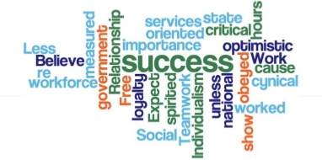
WORKING WITH THE BABY BOOMER
Work ethic is measured in hours worked
Relationship building is important
Expect loyalty and recognition from those they work with
Teamwork critical to success
Less importance on productivity
GETTING ALONG WITH THE BABY BOMMERS
Show respect
Choose face-to-face conversations
Give people your full attention
Learn the corporate history
MANAGING THE BABY BOOMER
Help them explore their next set of workplace options, and demonstrate how your organization can continue to use their talents
Walk the talk on work-life balance by redesigning their jobs to accommodate multiple life demands
Encourage them to enrich their present job and grow in place if they need to slow their career pace

Slide 69
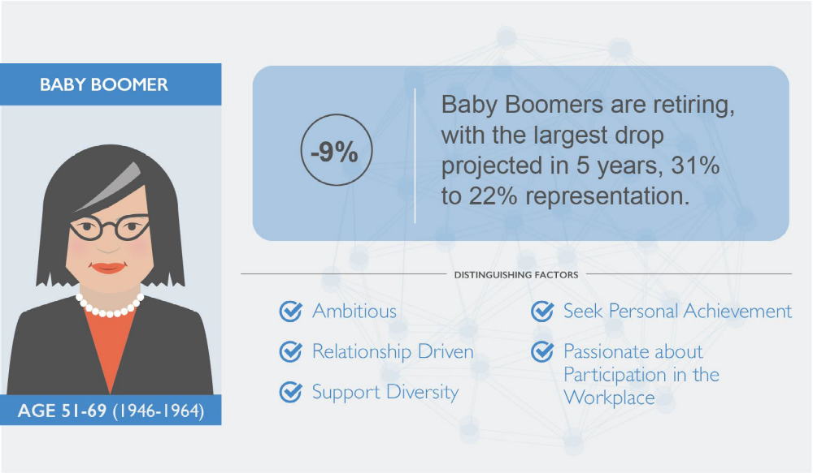

Slide 70
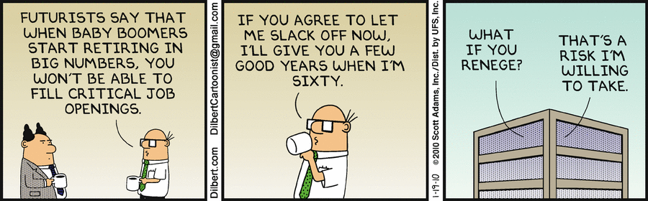
YOU MIGHT BE A BABY BOOMER IF…… YOU CAN COMPLETE THESE SENTENCES…
WHEN THEY FIRST COME TO THE U.S. IN EARLY 1964, WE ALL WATCHED THEM PERFORM ON THE _______ SHOW.

Slide 71
GENERATION X
BORN 1965 TO EARLY1980’S

Slide 72
GENERATION X
BORN 1965 TO EARLY1980’S
Grew up as latchkey or day care children
Turbulent economic times – downturn in 80s, upswing in 90s
Expect their career to keep moving forward or they
will leave
Friends with their child, want to spend quantity time
“Work to Live!”
Prefer electronic communications
Change from job security to career security

Slide 73

WORKING WITH THE GENERATION X
Work smarter not harder
Value control of their time
More electronic vs. face to face communication
Motivated by money
Has strong technical skills
Want jobs that give them personal fulfillment
GETTING ALONG WITH GENERATION X
Use email
Give them space
Get over the notion of dues paying
Lighten up
MANAGING THE GENERATION X
Talk to them about their reputation, not just job tasks; they want your candid perspective and feedback
Acknowledge their ability to work independently and encourage them to leverage their entrepreneurial abilities
Help them get the most out of every job position by discussing what the job can do for them and what they can learn from it

Slide 74


Slide 75

You might be a Generation Xer if……
Schoolhouse Rock played a HUGE part in how you learned….
“I’m just a Bill sittin’ on Capitol Hill”

Slide 76



Millennials AND
GENERATION Y
BORN EARLY 1980’S – MID 1990’S

Slide 77

Millennials AND GENERATION Y
EARLY1980’S – MID 1990’S
Attended day care, very involved “helicopter” parents
Prosperity has increased over their lifetime
“Live, then Work!”
Achievement oriented
Prefer instant or text messaging
Want to build parallel careers
Experts in multitasking

Slide 78

WORKING
WITH A Millennial AND GENERATION Y
Apt to change jobs more frequently
Want positive reinforcement from their bosses
More electronic vs. face to face communication
Like to be involved in the decision making process
Work to live, not live to work
Want open communication regardless of title, position, or tenure
GETTING ALONG WITH Millennial
AND GENERATION Y
Challenge them
Ask them their opinion and collaborate
Encourage finding a mentor
Provide timely feedback
Lighten up
MANAGING A Millennial
AND GENERATION Y
Demonstrate the stability and long-term value of your organization, and also show how your organization is flexible and filled with learning opportunities for them
Provide work schedules that help them build careers and families at the same time
Make groups and teams part of their job

Slide 79

Millennial AND GEN Y

Slide 80

You might be a Millennial if……
Blog, Myspace/Facebook, IM, text messaging and other social media is part of your daily life.

Slide 81
GENERATION Z
BORN AFTER 1997

Slide 82
GENERATION Z
BORN AFTER 1997
Parents let kids “figure it out”
Believe there is no job security
Learned traditional choices do not guarantee success
Raised with smartphones and social media
Gender roles changing
Shortened attention spans

Slide 83

WORKING WITH A GENERATION Z
Feel pressure to succeed
Value corporate social responsibility
Communicate with images and symbols
Can communicate with many people at the same time
Authenticity and diversity matter
GETTING ALONG WITH THE GENERATION Z
Give opportunities to lead
Offer work flexibility
Recognize their work
No micro-managing
Want personal mentorships
MANAGING THE GENERATION Z
More motivated by opportunities for advancement than they are by money
Sees the relationship between manager and employee as similar to the relationship between teacher and student
They believe that the workplace should be less about age and more about ideas and contributions

Slide 84


Slide 85


You might be a Generation Zer if……
If you express yourself in emojis

Slide 86
Time to Exercise…
Generations in the Workplace Quiz

Slide 87


Slide 88
MOTIVATION
Best Practices for the
Multi-Generational Workforce
88

Slide 89
MOTIVATING A MULTI-GENERATIONAL
WORKFORCE
Although each individual employee is different, there are certain governing principles that help motivate every worker, regardless of their age. While each generation responds slightly differently to these principles, it’s important to maintain an environment where everyone feels valued.
89

Slide 90

MOTIVATION THROUGH RECOGNITION
A recent global study by the O.C. Tanner Institute found that “employees, regardless of age, are more engaged, driven, and connected to the company when they’re recognized for their contributions. They have better work relationships too.”
90

Slide 91
5
Emphasize Mentoring
Encourage feedback and value it
Increase accountability and trust
Create a culture of respect
Give meaningful recognition
TIPS FOR
MOTIVATING
MULTI-GENERATIONAL
WORKFORCE
91

Slide 92
COMMUNICATION AND COLLABORATION
92

Slide 93

TIPS FOR
COMMUNICATING AND COLLABORATING
IN A MULTI GENERATIONAL
ENVIRONMENT
Engage in Different Learning Styles
Diversify Communication Strategies
Manage Expectations
93

Slide 94
FINDINGS ABOUT MANUFACTURING FROM
OMA STATEWIDE QUANTITATIVE RESEARCH

Slide 95

RESPONDENT PROFILE
Age
29
%
31
%
29
%
Current employment
Manufacturing
27
%
12
%
Technology
6
%
Development (software)
1
%
Retail
6
%
%
18-24
25-34
34-44
45-54
Utilities
0
Transportation/Distribution
3
%
Sales
4
%
%
Ethnicity
Healthcare/Medical
15
Military
1
%
Government
3
%
Banking/Finance
4
%
White
Education
7
%
Black
Construction
5
%
Asian/Pacific Islander
Engineering/Architecture
1
%
Hispanic
Food service/Hospitality
5
%
Other
Legal
1
%
Something else
11
%
Q1. What is your age?, N=269. Q3. Which of the following best describes you?, N=269. Q10. Now turning to
Fahlgren Mortine and iModerate/20|20 Research 2018
industries in the U.S., which of the following industries best describes your current employment? If you are not
N=219.
employed please indicate so.,

Slide 96
MANUFACTURING FAVORABILITY
Subgroup
Favorable
(
Top 2 Box
)
BY SEGMENT
Total Sample N=269
70
%
Millennial
Women
57
%
N=79
Gen X
Women
85
%
N=53
Millennial Men
70
%
Initial perceptions of the manufacturing
​
N=81
industry are 7 out of 10 (70%) overall. Gen X
Gen X Men
73
%
N=56
women (85%), Gen X Men (73%) have the
White
most positive first impressions.
N=228
70
%
Non
-
white
71
%
Students (41%) and millennial females
​
N=41
(57%)
had the lowest initial impression of
Employed
76
%
manufacturing.
N=219
Students
41
%
N=49

Slide 97

VITALITY OF MANUFACTURING
Q23 Based on what you know, please indicate whether you agree or disagree with the following
statements. Subgroup: 18
-
34
base N=191;
35
-
54
N=109.
HIGHER AMONG
GENX
Subgroup Findings: Millennials v. Gen X
Total Sample Findings
Agree (Top 2 Box)
Agree (Top 2 Box)
The U.S. manufacturing industry is a vital
87
%
The U.S. manufacturing industry is a
85
%
source of living-wage jobs.
vital source of living-wage jobs.
91
%
Manufacturing jobs fuel our nation's
81
%
Manufacturing jobs fuel our nation's
76
%
economy.
economy.
88
%
The manufacturing industry in the U.S. is
66
%
The manufacturing industry in the U.S.
68
%
competitive on the global stage.
is competitive on the global stage.
63
%
Manufacturing jobs occur in a safe and
Manufacturing jobs occur in a safe and
56
%
18-34
clean enviornment
57
%
clean enviornment
60
%
35-54

Slide 98
ENCOURAGEMENT
INTENDED MORE THAN
Q24. Please indicate whether you agree or disagree with the following statements. Total Sample,
RECEIVED
N=269.
I
would
encourage
Total Sample N=269 ”Agree”
my
child
Subgroup
to
pursue
a career in
manufacturing.
I would encourage my child
Millennial
to pursue a career in
58
%
Women
51
%
manufacturing
N=79
Gen X
Women
59
%
My local school system
43
%
N=53
encouraged its students
Millennial Men
N=81
68
%
High school administrators
40
%
Gen X Men
54
%
have encouraged me
N=56
White
57
%
My parents and family
40
%
N=228
members encouraged me
Non
-
white
63
%
Total Sample, N=269
N=41

Slide 99

STILL (SOMEWHAT)
DANGEROUS AND DIRTY

Slide 100
MILLENNIAL VS.
GENX
MEN
EARLY INFLUENCERS HAVE
IMPACT
Q24. Please indicate whether you agree or disagree with the following statements. Subgroup:
Millennial Men N=81, Gen X Men N=56.
My parents and family members have
36
%
encouraged me
61
%
Millennial men are more likely to have had
more encouragement from their family,
My K-12 local school system encouraged its
36
%
friends, and school administrators when it
students
62
%
comes to a career in manufacturing.
Gen X Men
Millennial Men
68
% of Millennial men say they would
High school administrators have encouraged
30
%
“encourage my child to pursue a career in
me
59
%
manufacturing.”
I would encourage my child to pursue a
54
%
career in manufacturing
68
%

Slide 101
MILLENNIAL
VS.
Q25. Below are reasons some people have given in support of a career in the manufacturing industry in
Ohio. For each, please indicate if it is a very convincing, somewhat convincing, not too convincing, or not
at all convincing reason to consider a career in manufacturing.
Subgroup, Gen X N=56, Millennial Men N=81.
GENX
MEN
Manufacturing spurs innovation and contributes
84
%
to the social good
8
0
%
TECH RESONATES
Manufacturing allows you to create with your
75
%
hands
79
%
WITH GENX
Manufacturing jobs afford a considerable work-
84
%
life balance
78
%
The manufacturing industry in the U.S. is high-
70
%
Gen X Men
tech.
84
%
Millennial Men
U.S. manufacturing jobs are stable and provide
77
%
as much job security as other jobs in other
75
%
industries.
Manufacturers have one of the highest
86
%
percentages of workers who are eligible for
89
%
health benefits provided by their employer
Manufacturing jobs pay really well.
82
%
83
%

Slide 102


Slide 103
REVIEW: RECOGNIZING GENERATIONAL TRAITS IS A TOOL FOR IMPROVING GROUP DYNAMICS
Traditionalists
Baby Boomers
Gen X
Millennials
Gen Z
Next Gen
We are all individuals and a product of both our nature & nurture….
family, community & culture

Slide 104
DIFFERENCES BETWEEN MILLENNIALS AND ZS
Millennials spent money boldly and with few boundaries
Millennials grew up during a strong economy
Millennials subscribed to everything social
Millennials watched YouTube, Hulu and Netflix
Millennials loved sports and adventure
Millennials grew up with slightly longer attention spans
Millennials would initiate text for communication
Millennials enjoyed a life that revolved around them
57 percent of Generation Z prefers saving money to spending it.
Generation Z is growing up in a time of recession, terrorism, violence, volatility and complexity.
Generation Z does not wish to be tracked and prefers more private networks like Snapchat, Whisper, Secret, and Yik Yak.
Generation Z creates content and interactive work.
Generation Z sees sports as a health tool, not for play. Their games are inside. Teen obesity has tripled since 1970.
Generation Z has an attention span of 8 seconds.
Generation Z prefers communicating through images, icons and symbols.

Slide 105
GEN-Z, I GENERATION, ETC., ETC.
Born between 1995-2009… (dates vary)
Received Phone
Average Age of 9
64 Million
More Budget Conscious

Slide 106
GENERATION Z
They multitask on five screens, not one or two. They experience FOMO: the "Fear Of Missing Out." They try to consume it all.
They plan to get educated and start working earlier, but will be "school hackers" and not necessarily attend a liberal arts college.
75% wish their current hobby could become their full-time job.

Slide 107

THEIR WORLD...
Biggie has always been dead
Chris Farley has always been dead
South Park has always been on
Hong Kong has always belonged to China
Sheep have always been cloned
Presidents have always had two terms
Columbine- 2 years old
9/11- 4 years old
Hurricane Katrina- 8 years old
iPhone- 10 years old
Deepwater Horizon- 13 years old

Slide 108
HOW TO MOTIVATE THESE STUDENTS...
Create high-intensity relationships: They react better to highly defined, small workgroups that have a strong peer leader. There must be an easy to identify chain of command when it comes to management.
Generation Z students may need more training, especially in the area of interpersonal and communication skills. Focus on behaviors--show them the right skills and communication techniques.
Provide lots of awards: This generation has grown up used to rewards for even the smallest accomplishment. To encourage performance and growth, offer periodical rewards and continue redesigning the rewards to meet the changing expectations.
Generation Z students thrive on opportunity. If you want to keep them interested and motivated, show them a dream opportunity is possible.

Slide 109





THANK YOU!
Questions?
Ohio Manufacturing Extension Partnership
Susan Foltz
Email: susan.foltz@development.ohio.gov
Ohio Manufacturing Extension Partnership at Ohio State University South Centers
Dorinda Byers
Email: byers.18@osu.edu

